Slide 1
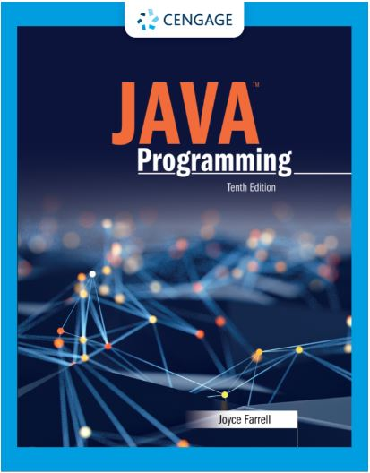
Java Programming, 10e
Chapter 03: Using Methods
Joyce Farrell, Java Programming, 10th Edition. © 2023 Cengage. All Rights Reserved. May not be scanned, copied or duplicated, or posted to a publicly accessible website, in whole or in part.

Slide 2
Chapter Objectives
By the end of this chapter, you should be able to:
03.01 Describe method calls and placement
03.02 Identify the parts of a method
03.03 Add parameters to methods
03.04 Create methods that return values
03.05 Describe blocks and scope
03.06 Overload a method
03.07 Avoid ambiguity
Notes:
Instructions:
Briefly review with students the major concepts you will be covering during this class. There is one objective for every major A-Head section of the chapter.

Slide 3
3.1 Understanding Method Calls and Placement (1 of 3)
Method
A program module
Contains a series of statements
Carries out a task
Execute a method
Invoke or call from another method
Calling method (client method)
Makes a method call
Called method
Invoked by a calling method

Slide 4
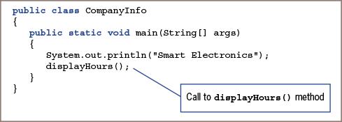
3.1 Understanding Method Calls and Placement (2 of 3)
Figure 3-3: CompanyInfo class that calls the displayHours() method

Slide 5
3.1 Understanding Method Calls and Placement (3 of 3)
Advantages to creating a separate method instead of adding statement to the original application include:
Keeps the main () method short and easy to follow
Using a well-named method makes it easy to see the overall intent
A method is easily reusable

Slide 6
3.2 Understanding Method Construction (1 of 5)
Every method must include two parts:
Method header
Provides information about how other methods can interact with it
Also called method declaration
Method body
Contains statements that carry out the work of the method
Between a pair of curly braces
Called its implementation

Slide 7
3.2 Understanding Method Construction (2 of 5)
Method header
Optional access specifiers
Optional static modifier
A return type
An identifier
Parentheses (may or may not be empty)

Slide 8
3.2 Understanding Method Construction (3 of 5)
Access Specifiers
public, private, protected, or package (default)
Any method that can be used without instantiation an object requires the static modifier

Slide 9
3.2 Understanding Method Construction (4 of 5)
Return Type
Describes the type of data the method sends back to the calling method
If no data is returned to the method, the return value is void
Method Name
Can be any legal identifier
Must be one word
No embedded spaces
Cannot be a Java keyword

Slide 10
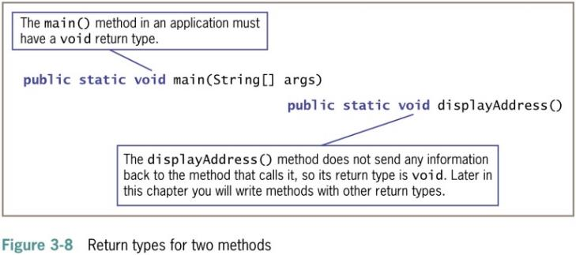
3.2 Understanding Method Construction (5 of 5)
Parentheses
Every method header contains a set of parentheses that follow the identifier
May contain data to be sent to the method
Fully qualified identifier
A complete name that includes the class

Slide 11
Activity 3.1: Knowledge Check
What happens when no data is returned to the method?
The return value is void
The program stops because of a logical error
The result is ambiguous
The method is skipped over
Notes:
Instructions:
Use the Knowledge Check questions to periodically pose a question to students during class to gauge how well they can recall the material that was presented.

Slide 12
Activity 3.1: Knowledge Check Answer
What happens when no data is returned to the method?
Answer: a. The return value is void
Not all methods return a value to their calling methods. A methods that returns no data has a return type of void. The main() method in an application must have a return type of void.
Notes:
Instructions:
Use the Knowledge Check questions to periodically pose a question to students during class to gauge how well they can recall the material that was presented.

Slide 13
3.3 Adding Parameters to Methods (1 of 5)
Arguments
Data items you use in a call to a method
Parameters
Data items received by the method
Methods that receive data produce different results depending on data received

Slide 14
3.3 Adding Parameters to Methods (2 of 5)
Implementation hiding
Encapsulation of method details within a class
The calling method needs to understand only the interface to the called method
Interface
The only part of a method that the client sees or with which it interacts

Slide 15
3.3 Adding Parameters to Methods (3 of 5)
Creating a method that receives a single parameter
If a method receives a parameter, two additional items are required within the parentheses:
Parameter type
Local name for parameter
Local variable
Known only within the boundaries of the method

Slide 16
3.3 Adding Parameters to Methods (4 of 5)
Creating a Method That Requires Multiple Parameters
A method can require more than one parameter
List the arguments within the call to the method
Separate with commas
Each parameter requires a data type and identifier
Signature
Combination of method name and number, types, and order of arguments

Slide 17
3.3 Adding Parameters to Methods (5 of 5)
Arguments sent to the method must match the parameters listed in the method declaration by:
Number
Type
Method signature
Method name
Number, types, and order of the arguments

Slide 18
3.4 Creating Methods That Return Values (1 of 3)
A method ends when any of the following events occur:
Method completes all of its statements
Method throws an exception
Method reaches a return statement

Slide 19
3.4 Creating Methods That Return Values (2 of 3)
Return statement
Causes a value to be sent from the called method back to the calling method
The return type can be any type used in Java
Method’s type
Common name for method’s return type

Slide 20
3.4 Creating Methods That Return Values (3 of 3)
Unreachable statements
A statement placed after a method’s return statement
Can never execute
Dead code

Slide 21
Activity 3.2: Discussion
Explain the advantages of creating a separate method that can be called in the main() method.
Describe the roles that the following play in a method: parameter, return statement, and blocks.
Notes:
Instructions:
Use the Discussion activity to encourage group conversation about a related topic of interest.

Slide 22
Activity 3.2: Discussion Debrief
Some advantage to creating a separate method include:
Using a method call keeps the main() method short and easy to follow.
It is easy to see the intent of the separate statements when you use a well-named method.
Methods are easily reusable.
A parameter is used when a method needs to receive a data item. A return statement causes a method to end, and the program’s logic to return to the calling method. A block is the code between a pair of curly braces within a class or method; inner blocks can be nested inside an outer block.
Notes:
Instructions:
Use the Discussion activity to encourage group conversation about a related topic of interest.

Slide 23
3.5 Understanding Blocks and Scope (1 of 5)
Block of code
Any code between a pair of curly braces
Also called a block

Slide 24
3.5 Understanding Blocks and Scope (2 of 5)
Outer block
Begins at first opening curly brace
Ends at last closing curly brace at end of method
Inner block
Begins with second opening curly brace
Ends with first closing curly brace
Contains two executable statements:
Nested within outer block

Slide 25
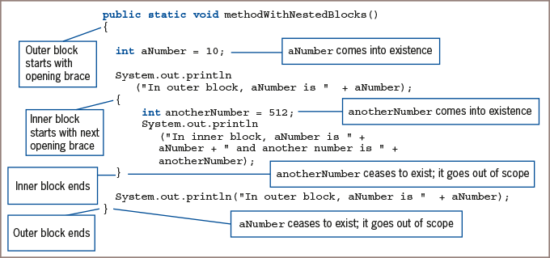
3.5 Understanding Blocks and Scope (3 of 5)
Figure 3-20: A method with nested blocks

Slide 26
3.5 Understanding Blocks and Scope (4 of 5)
Come into scope
When a variable comes into existence
After it is declared
Goes out of scope
At the end of the block in which it is declared
Scope level
A variable’s block

Slide 27
3.5 Understanding Blocks and Scope (5 of 5)
Redeclare a variable
Declare a variable more than once in a block
Illegal action
You can declare a variable within one method of a class and use the same variable name in another method of the class

Slide 28
3.6 Overloading a Method (1 of 2)
Overloading
Allows you to use one identifier to execute diverse tasks
Writing multiple methods in the same scope with the same name but different parameter lists
Lists must have different numbers of parameters
Lists must have parameter data types in different orders
Multiple methods share a name
Compiler understands which to use based on arguments in the method call

Slide 29
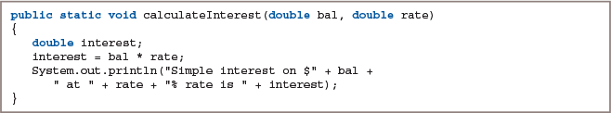
3.6 Overloading a Method (2 of 2)
Figure 3-28: The calculateInterest() method with two double parameters

Slide 30
3.7 Learning about Ambiguity (1 of 1)
Ambiguous situation
Where the compiler cannot determine which method to use
Caused by overloading
If a program contains potentially ambiguous situations, it will run problem-free if you do not make ambiguous method calls

Slide 31
Activity 3.3: Think, Pair, Share
Form pairs or groups of 2 to 4 class members.
Create an application with a main() method that prompts the user for three values to be used in a calculation.
Create a method that uses the three values to perform at least four calculations.
Use overloading as part of your programming.
Make a note of any ambiguity issues that may occur.
Notes:
Instructions:
Use the Think, Pair, Share activity to encourage students to solve problems collaboratively and to apply the real-world skill of evaluating, modifying, and debugging code created by another programmer.

Slide 32
Activity 3.3: Think, Pair, Share Debrief
What three values did your program prompt users to input?
List the type of calculations that your program performed.
What overload methods did you select? Why?
What possible ambiguity issues might occur? How will you prevent them?
Notes:
Instructions:
Use the Think, Pair, Share activity for students to work on individually, compare their results with a partner, and then to present a solution to the class.

Slide 33
Don’t Do It
Don’t place a semicolon at the end of a method header.
Don’t try to use a variable that is out of scope.
Don’t assume that a constant is still a constant when passed to a method’s parameter.
Don’t try to overload methods by giving them different return types.

Slide 34
Self-Assessment
Does the order in which methods appear in a class affect the order in which methods are called or executed?
What type of information should you include in the method header?
How does creating a method that receives a single parameter differ from creating a method that receives multiple parameters?
What makes a statement an unreachable statement? Why should you avoid them?
What happens when you redeclare a variable?
Notes:
Instructions:
Use the Self-Assessment question to encourage students to evaluate their progress or goals in the course, as well as determine how they might apply their learning or grow as an individual.

Slide 35
Summary
Click the link to review the objectives for this presentation.
Link to Objectives
Notes:
Instructions:
Reiterate the learning objectives for the lesson. Students should use this information to guide their studies and reinforcement of new concepts.

